Slide 1
Introduction to business intelligence and big data analytics
Tips and tools for creating and presenting wide format slides

Slide 2
Learning Objectives
Define business (data) analytics
Describe the scope of business (data) analytics
Outline business intelligence trends and big data trends

Slide 3
What is Business (Data) Analytics?
The practice and art of bringing quantitative and qualitative data to bear on decision-making.
Business analytics, or more generally data analytics, include a range of data analysis methods, ranging from business intelligence to advance analytics techniques.

Slide 4
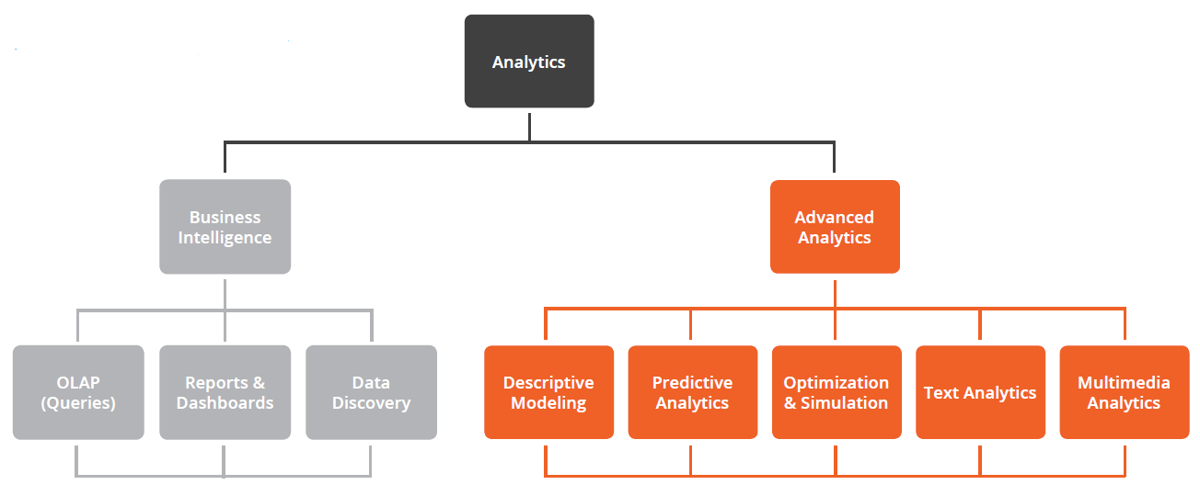
Scope of Business Analytics
Business Intelligence vs. Advanced Analytics View
Source: RapidMiner Whitepaper

Slide 5
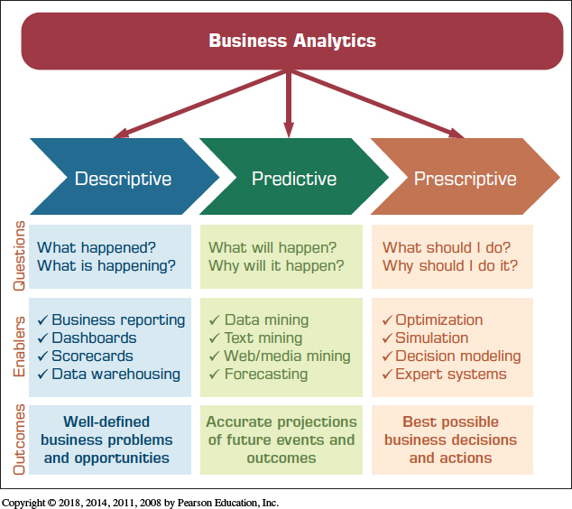
Scope of Business Analytics
Another View: Three Types of Analytics

Slide 6
Scope of Business Analytics
Descriptive Analytics
Descriptive or reporting analytics
Answering the question of what happened
Retrospective analysis of historic data
Enablers
OLAP / DW
Data visualization
Dashboards and Scorecards
Descriptive statistics

Slide 7
Scope of Business Analytics
Predictive Analytics
Aims to determine what is likely to happen in the future (foreseeing the future events)
Looking at the past data to predict the future
Enablers
Data mining
Text mining / Web mining
Forecasting (i.e., time series)

Slide 8
Scope of Business Analytics
Prescriptive Analytics
Aims to determine the best possible decision
Uses both descriptive and predictive techniques to create the alternatives, and then determines the best one
Enablers
Optimization
Simulation
Multi-Criteria Decision Modeling
Heuristic Programming

Slide 9
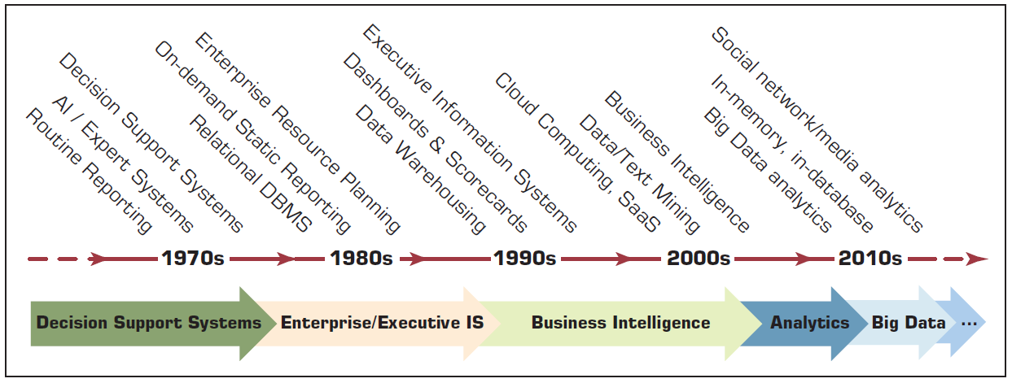
Evolution of computerized Decision Support to Analytics/Data Science
Source: Pearson Education

Slide 10
Current Business Intelligence Trends
Top Three
Master data/data quality management
Data discovery/visualization
Self-service BI

Slide 11
Current Trends in Big Data
Big data and open source (Apache Hadoop, Spark, and others) will continue to dominate the big data space
In-memory database technology – attempt to speed up big data processing
Machine learning – sophisticated analysis of existing big data stores
Big data intelligent Apps – apps that incorporate big data analytics in order to provide personalization & better service
Intelligent security – many organizations are incorporating big data analytics into their security strategy
IoT – handling and making sense of big data coming from IoT deployments

